Slide 1

Weather Impact on U.S. Shipment Delays
Tomeka Pena
Master of Science, Data Engineering
Western Governors University
June 29, 2026

Slide 2

Introduction and Background
Graduate student in Data Analytics – Data Engineering
Bachelors of Data Analytics, WGU
Data Analytics professional in the tire manufacture industry

Slide 3
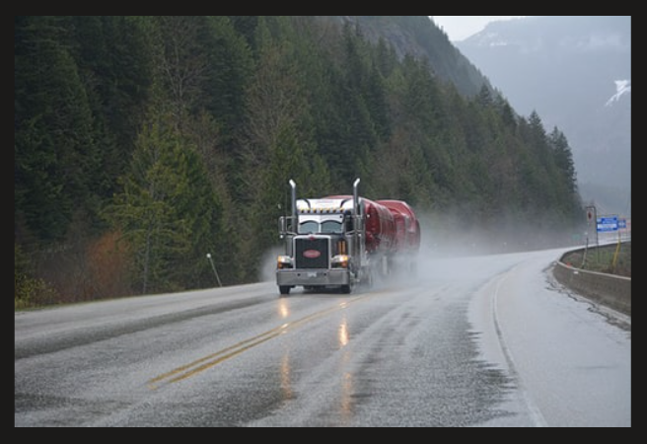
Problem Statement & Hypothesis
Research Question
  Do weather conditions significantly influence shipment delays within U.S. supply chain operations?
Null Hypothesis
  Weather conditions do not have a statistically significant relationship with shipment delay risk.
Alternative Hypothesis
  Weather conditions have a statistically significant relationship with shipment delay risk.

Slide 4
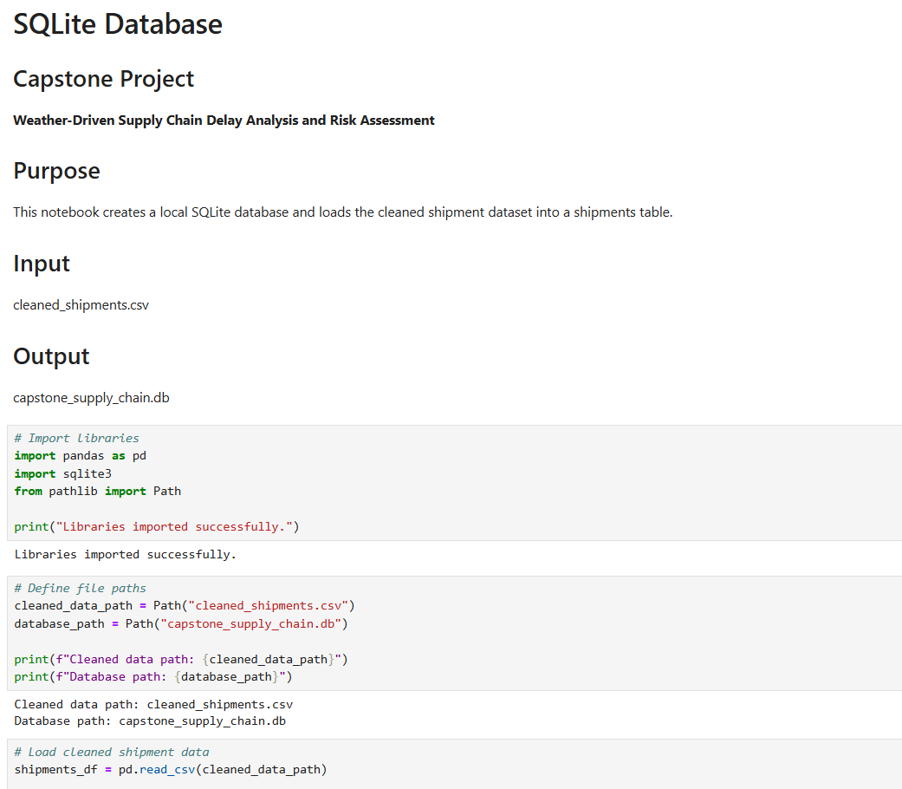
Data Collection & ETL Process
Data Sources
  DataCo SMART Supply Chain dataset
  Open-Meteo Historical Weather API
ETL Process
  Extract shipment records
  Retrieve historical weather data
  Clean and standardize datasets
  Store data in SQLite
  Join shipment and weather datasets
  Validate integrated dataset

Slide 5
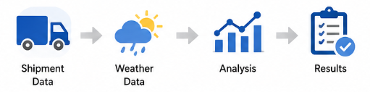
Data Analysis
Analytical Techniques
  Descriptive statistics
  Weather category summaries
  State comparisons
  Pearson correlation analysis
  Chi-square test of independence
  Interactive Power BI dashboard

Slide 6
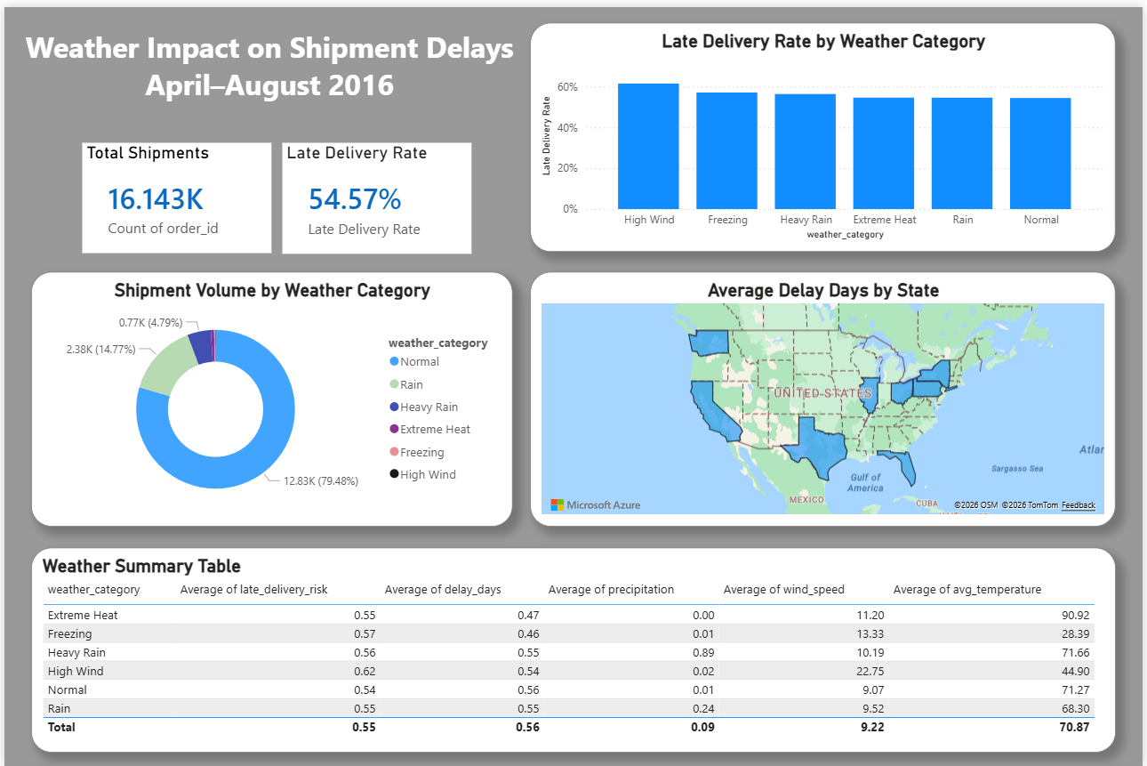
Power BI Dashboard

Slide 7

Findings
Key Findings
16,143 shipment records analyzed
1,224 historical weather observations integrated
Late delivery rates were similar across weather categories
Correlation coefficients were close to zero
Chi-square test found no statistically significant relationship
  Chi-square statistic: 1.4822
  p-value: 0.915116
Conclusion
Weather conditions were not a primary driver of shipment delays within this dataset.

Slide 8

Limitations
Weather represented by one reference city per state
Route-level weather was not available
Analysis limited to April–August 2016
Other logistics variables were not included
  Carrier performance
  Warehouse operations
  Routing decisions
  Staffing

Slide 9

Recommendations
Proposed Actions
Investigate operational factors affecting delays
Improve routing and logistics planning
Expand future analyses using additional logistics data
Incorporate route-level weather observations

Slide 10
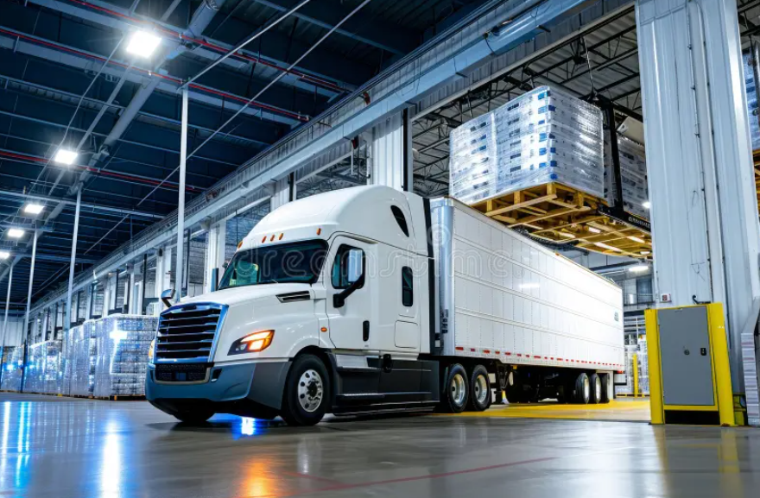
Expected Benefits
Data Engineering Benefits
Successfully integrated 16,143 shipment records with 1,224 historical weather observations.
Produced a unified dataset containing 22 analytical variables for reporting and future analysis.
Developed a repeatable ETL pipeline that can be rerun with updated shipment or weather data.
Business Benefits
Identified that weather was not a statistically significant driver of shipment delays during the study period.
Enables logistics managers to prioritize operational improvements rather than assuming weather is the primary cause of delays.
Provides a reusable analytical framework that can be expanded with additional operational data.
Future Benefits
Can support predictive analytics by incorporating:
  carrier performance
  warehouse processing times
  transportation routes
  shipping distance
  fulfillment center information

Slide 11

Conclusion
Summary
Integrated shipment and weather datasets
Built a complete ETL pipeline
Created an interactive Power BI dashboard
Applied statistical analysis
Found no significant relationship between weather and shipment delays

Slide 12
Thank You

